Slide 1
Development of an Embedded Communication Hub for the Acquisition of Sensor Data in a Robotic System
Project Thesis Juan Carlos Reyes Andrade, ICS
V2 (2020.04.28)

Slide 2
Contents
Background
RTE Networks
Main goal
Specific goals
Solution proposal
Tasks table
Timeline

Slide 3
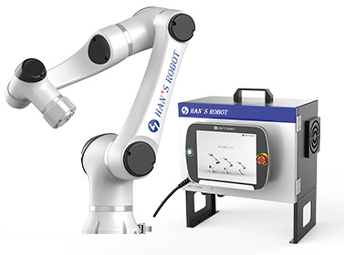
Background
Robotic applications increasing their multi-connectivity
Collaborative robots
Peripherals
2D/3D vision systems
HMIs
Sensors/Actuators
Industrial shift into the Real Time Connectivity
Notes:
Multiconnectivity: collaborative robots, peripherals sensors and cameras, hmi (touchscreens) any other remote host (interfaces, protocols)*** Difference
IEC61784 part II as an evolution of the field buses
Within ai-ec?** Communication Profiles Families – most of the private profiles/commercial protocols CAN/PROFibus/Powerlink/Profinet/EtherCAT/DeviceNet are addressed
Within the set of data -> Time Sensitive Data -> Data that needs to meet strict time deadlines to ensure the right functionality of the whole system.
The need was already in the industry but it increases as the networks get more complex and diverse and when the market/research offers constantly more and more devices which can or not have RT processing. However, data stream in the network must ensure that the RT Data is not affected by the traffic.
Robots controllers (positions, movements/speeds, time-critical actuators). 3D Cameras.
Rely on RT data.
Within the market and out of it there is already tools that address compatibility with private devices/standards.
----------------
IEC 61158 represents a collection of communication profile families (CPFs), each of them including some communication profiles (CPs), which refers to different and well established commercial protocols. Neither DeviceNet nor CANopen is encompassed by IEC 61158 even though they are two widespread fieldbuses. These two networks rely on the popular CAN.

Slide 4








Background: RT Ethernet Networks
Fieldbuses were included within IEC 61158 (CPFs) 1988-1999
RTEN referenced to IEC61784 part II 2008
Two strategies to ensure RT communication:
TDMA and CIP (Common Industrial Protocol)
TSN Group improves the Data Link and MAC Layer (IEEE802.1Qbv) 2012-2019
Open-source tools offer compatibility → Further development
Licensed RTE Solutions:
Open source tools:
Notes:
We have open source tools that now can provide a reliable framework to design on top of them
Usch that they can be tested against the international standards and also with compatibility with the “parivit” vendors.
As history dictates, vendor protected technology have a limit when there are lots of possibilities a non standards.
By 2008 CPF 1: FOUNDATION Fieldbus
CPF 2: CIP
CPF 3: PROFIBUS
CPF 4: P-NET
CPF 5: WorldFIP
CPF 6: INTERBUS
CPF 7: SwiftNet (withdrawn)
CPF 8: CC-Link
CPF 9: HART
CPF 10: Vnet/IP
CPF 11: TCnet
CPF 12: EtherCAT
CPF 13: Ethernet Powerlink
CPF 14: EPA
CPF 15: MODBUS-RTPS
CPF 16: SERCOS^{[5][6]}
DeviceNET and CAN open were not included in IEC 61158
RTEN Started during the early 2000s (evolution of the field buses)
Referenced to IEC61784 part II *** (year?)
Examples are EtherCAT [83], Profinet [84], Ethernet/IP [85], Ethernet, Powerlink [26], and Modbus TCP [86]
2 Technics to ensure RT communication: TDMA (Time Slots to transmit packets) and CIP (Common Industrial Protocol Labeled– HP -> UDP; LP -> TCP)
TSN Group improves initiave that started in 2012 by adding them the AVB Group
Well-known industrial trademarks
User perspective it is unsatisfactory, since it is only a trademark wark. Sometimes the IEC based solutions are not longer compatible with the IEEE 802.3 Ethernet Specification**
Therefore TSN (2012) official attempt to integrate the technologies to an standard, as it happened with classical Ethernet (AVB* in 2003-2005 -> industrial environments)
A set of tools that comply the international standard (mostly improvements within the ISO/OSI layer 2 DATA LINK**).
IEEE802.1Qbv implements a time slot and traffic shapping mechanism
The problem is not a synchronization problem between the EtherCAT and the TSN? Distributed clocks vs GCLs
Ethercat uses TDMA but differs with POWERLINK and Profinet IRR, difference rely within the MAC layer Telegram RT vs maibolxes NRT
Where does EtherCAT live within the OSI model? Is application layer or Network/Transport layer?
What about the PROFINET? If it sticks to ETHERNET, is it easier for it to switch to the new standard?

Slide 5

Main goal
“Develop a device using open-source tools to read out sensor data from a robot axis that can be interfaced with a RTE Network.
The device could be used afterwards as a test platform within an industrial environment to characterize its compatibility with the ongoing IEC/IEEE 60802 TSN Profile for Industrial Automation.”

Slide 6
Specific goals
To specify the requirements of the system
Comparison taking into account the state of the art
To develop the embedded system as a functional EtherCAT Slave Device
Integrating FreeRTOS-CMSIS with SOES (Open-source tools)
Integrating the LAN9252 (SoC over SPI)
Reading out of axis temperature sensors
Controlling the axis LED Ring (WS2812b)
Designing the required user application libraries
To design and manufacture a PCB prototype using Altium Designer
To test and report the system functionality
Notes:
Readout of different sensors e.g. IMU (SPI), Encoders (BiSS-C),…

Slide 7

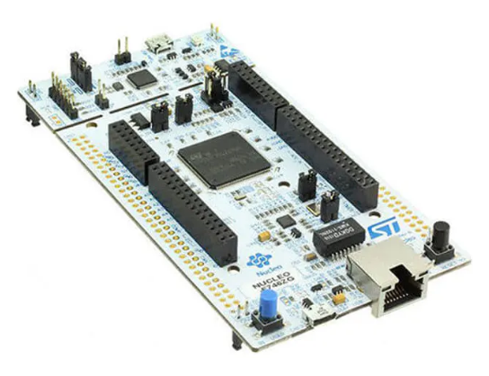
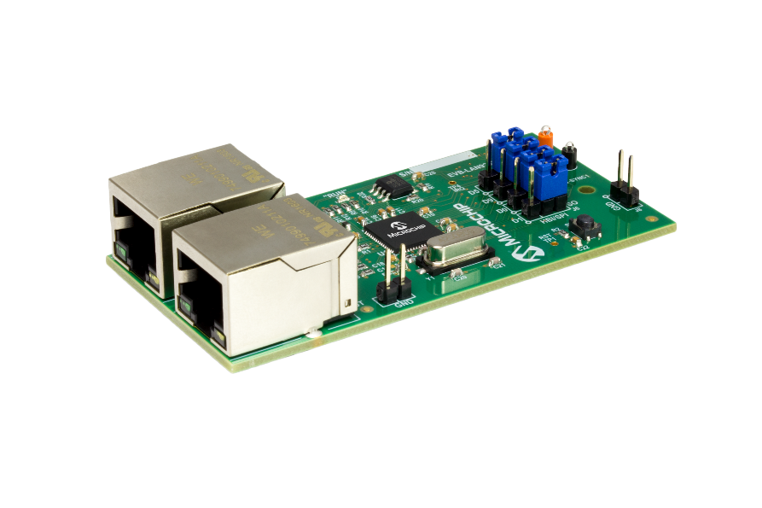

Solution proposal
Layered structure of functional blocks
Main HW: STM32Nucleo Board, Microchip LAN9252 SPI Eval Board
Notes:
Comparison with other strategies for reading out data? Interface different protocols → for sure it is a tailored solution
Embedded system --> kits already developed
Why is it not vendor solution but tailored programmed → Because of the Know-How and design experience
Why is it not compatible with Profinet or CAN?
Due to the given compatibility of the Robot ETHERCAT-CAN
EtherCAT is considered within the upcoming TSN Industrial Profile – CAN?
CAN is so far not compatible with the TSN?
Personal experience (advantages STvsMicrochip)

Slide 8
Timeline
Duration: ~4 Months
Official start: 29.04 Final Presentation: 07.09 (Proposal)
Final test with 2nd PCB Thu 20.08.20 - Mon 24.08.20
Start Wed 29.04.20
May
June
July
August
September
Finish Thu 10.09.20
SW and HW Development for 1st PCB Wed 29.04.20 - Fri 29.05.20
SW for EtherCAT comm/control features Wed 03.06.20 - Wed 24.06.20
SW for EtherCAT Data features Fri 26.06.20 - Tue 28.07.20
HW Development for 2nd PCB Thu 30.07.20 - Wed 19.08.20
Final report Tue 25.08.20 - Mon 07.09.20
SoSe Examination Period Wed 29.07.20 - Thu 10.09.20
Kick-Off Meeting Wed 29.04.20
Report of tests with 1st PCB Tue 02.06.20
Report of tests with EtherCAT comm/control features Thu 25.06.20
Report of tests with EtherCAT data features Wed 29.07.20
Final presentation Mon 07.09.20

Slide 9
Dankeschön für Ihre Aufmerksamkeit!

Slide 10
Extra information

Slide 11
Gantt Chart
Duration: ~4 Months
Official start: 29.04 Final Presentation: 07.09 (Proposal)

Slide 12
Main topics
Programming of software for embedded systems
STM32 MCUs with ARM architecture
Communication Interfaces (UART, I2C, BiSS, SPI)
Real Time tools (FreeRTOS - CMSIS)
Programming with industrial tools
Integration of an industrial protocol software stack into RTOS (SOES)
RT Ethernet Industrial Protocols (EtherCAT)
External configurations
EtherCAT Host (Beckhoff)
External documentations
TSN Industrial profile specification 2019

Slide 13
- [05.29] First PCB will be able to measure the temperature, interface over Uart to any serial host, control the LEDs and will only have the pinouts for SPI and BiSS connections. Tasks will be handled with a basic FreeRTOS approach. PCB will connect directly to the Nucleo and the LAN9252 Eval Board (firmly assambled, no-MCU on the manufactured board, 2X SPI Ports, 4X Temperature sensor connectors and X-Ports to LEDs).
- [06.24] First EtherCAT Slave Test - This will have at least a running framework for SPI communication, initial configuration of the LAN9252 Eval Board and a test data flow coming from the temperature sensor to the Master. It will run over the Nucleo Board.
- [07.24] Second EtherCAT Slave Test - This should exchange the data coming from sensors and saving/updating the control data coming from the Master. All the data should be structured according to the Robot application. Important to notice , the BiSS Encoder is not included in this version.
- [08.21] Second PCB - This PCB will improve the first version having the MCU considered to replace the attached Nucleo Board and adding any component that might be needed for signal instrumentation. Any code improvement could be also added to adjust the several ports considered in the PCB design.
- [08.26-28] Final Presentation - Mainly it would be focused on the integration of SOES with the RTOS to create a device that will be the base for a future performance analysis within TSNs for industrial applications. Also the current status of the TSN initiative and any discussion that might appear due to the employment of open-source tools.

